Slide 1
Forecasting Stock Prices Using Multiple Time-Series Models
Quang Viet Tran

Slide 2
Agenda
01
BACKGROUND
04
RESULTS
02
DATA PIPELINE
05
CONCLUSION
03
MODELING METHODS

Slide 3
Background
Started off as an “application of timesfm” project
Grew over time into model comparison project
Goal: examine prediction accuracy of different time series models on stock closing price

Slide 4
Data Pipeline
Pick a ticker (for this demonstration: AAPL)
Retrieve closing price from yfinance, 01/01/2014 - 01/01/2024. Split into train set (first 9 years) and test set (last year)
Apply model to the train set, predict test set
Compare model accuracy through RMSE, MAE (2025 addition)

Slide 5
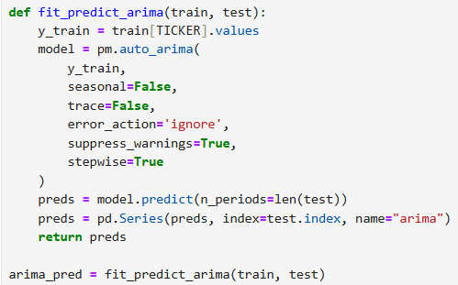
Modeling methods
1st model: ARIMA
Most basic time series model, serves as baseline
Assumes stationarity + linear relationship
Simple, fast, interpretable, but unrealistic assumptions -> likely to be inaccurate
In Python: pmdarima.auto_arima

Slide 6
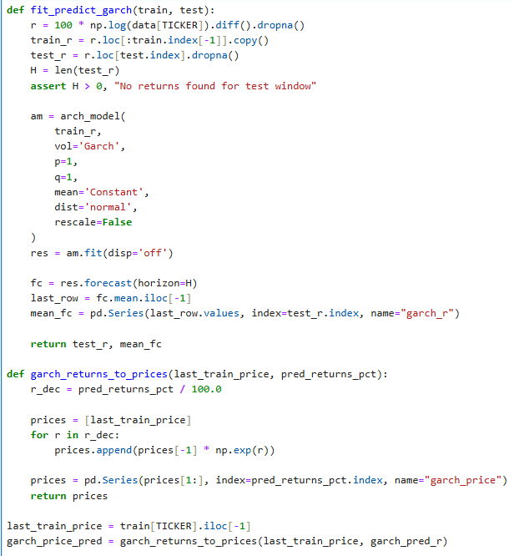
Modeling methods
2nd model: GARCH
Model for volatility, rejects ARIMA’s assumption
Fast and interpretable
Useful for assessing volatility, not so much for price prediction (cannot predict direction)
In Python: arch.arch_model

Slide 7
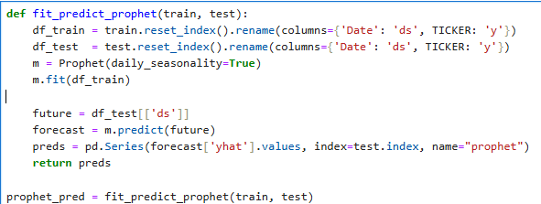
Modeling methods
3rd model: Prophet (Meta)
Assumes time series = trend + seasonal + holiday components
Historically useful for business time series, not financial time series
In Python: prophet.Prophet

Slide 8
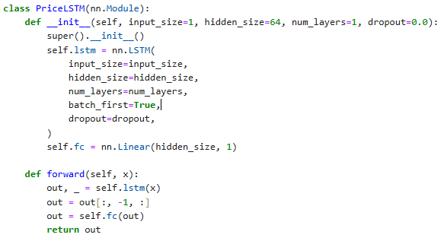
Modeling methods
4th model: LSTM
Deep learning model, useful for capturing non-linear relationship
Includes “forget gate” - determines how much of past data to incorporate
Historically useful for financial time series prediction
Computationally intensive, requires hyperparameter tuning, hard to explain
In Python: PyTorch

Slide 9
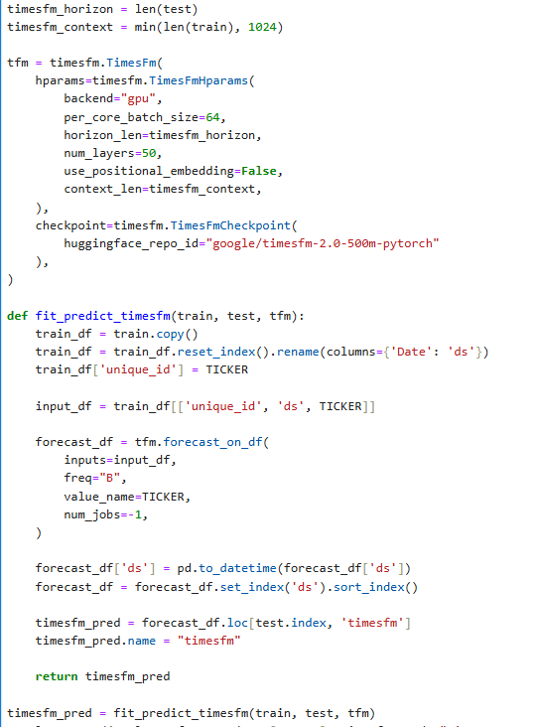
Modeling methods
5th model: timesfm (Google)
Pre-built foundational model, 200M parameters (2025 update: 500M)
Transformer-like architecture
Computationally intensive, full black-box model
2025 update: 2 modes: expanding window/rolling window
In Python: timesfm.timesfm

Slide 10
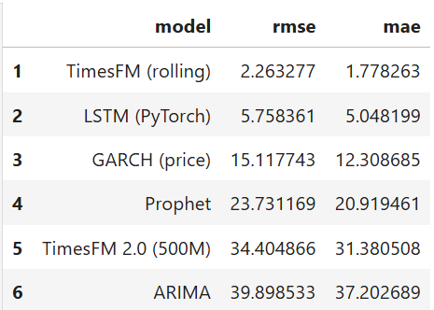
Results - Comparison table

Slide 11
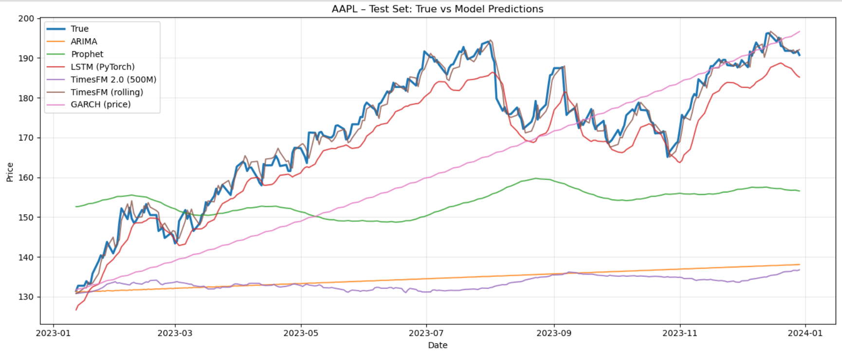
Results - Plot

Slide 12
Conclusions - Observations
ARIMA and Prophet underperform
GARCH excels only at modeling volatility (RMSE = 1.216 before price transformation), not direction
LSTM performs very well even with minimal hyperparameter tuning
timesfm surprisingly underperforms heavily (2024 conclusion).
2025 update: expanding window underperforms, rolling window performs incredibly well
2025 update: time constraint proves to be biggest obstacle

Slide 13
Conclusion - Improvements
Hyperparameter tuning for LSTM + timesfm
Better computing for timesfm rolling window
Run the entire pipeline on a portfolio of stocks
Look into effectiveness of model-agnostic explanation methods

